Slide 1
Team 7
Two-Dimensional Steady Heat Conduction and Transiet Heat Conduction using Numerical Methods
By: Eric Rios, Ricardo Orozco, Eddie Rangel, Brandon Penesa

Slide 2
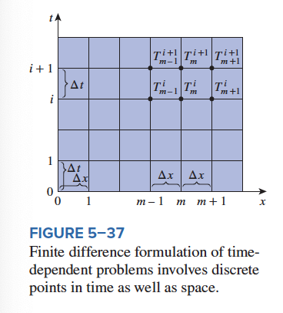
Topic: Transient Heat Conduction
Unlike steady heat conduction, temperature variation with respect to time AND position
Finite Difference Method
Since its transient, finite difference solution need to discretization in space and time
discretization is the process of transferring continuous functions, models, variables, and equations into discrete counterparts.
This is done by selecting suitable time Δt and solving for the unknown nodal temperatures repeatedly for each Δt until the solution at the desired time is obtained

Slide 3
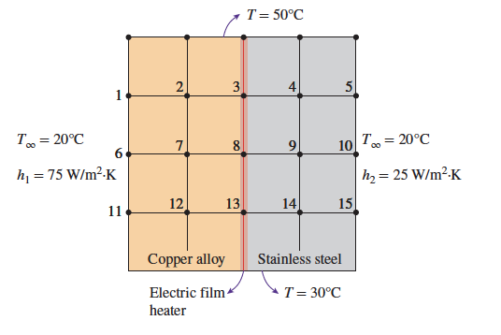
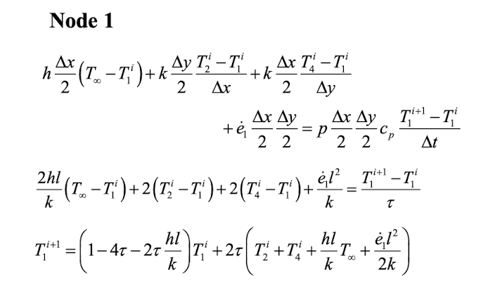
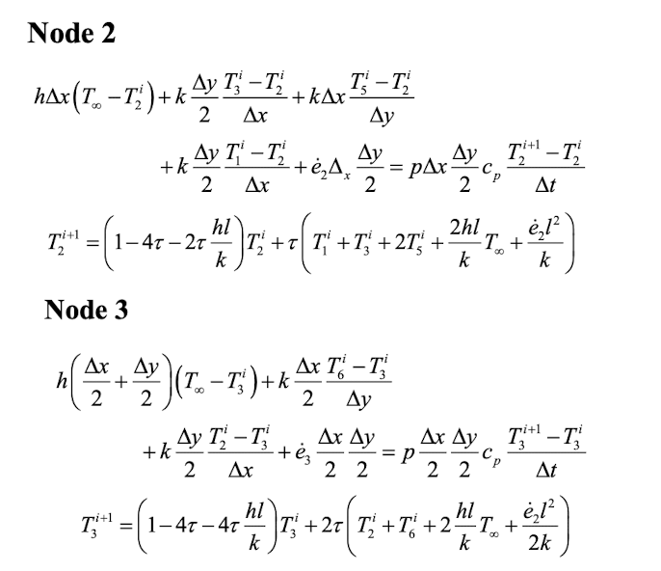
Heat Transfer Problem Setup
Want students to be able to use a user-defined function to calculate the temperature distribution between two different materials
Solve for temperature for each time and position interval using finite difference method equations (x15)
Give maximum temperature
Give minimum temperature

Slide 4

Solution and Procedure
The following the inputs are needed:
Thermal conductivity of material #1 (k1)
Thermal conductivity of material #2 (k2)
Ambient temperature (Tinf)
Heat transfer coefficient of material #1 (h1)
Heat transfer coefficient of material #2 (h2)
Length in the x direction (Dx)
Length in the y direction (Dy)
Heat transfer rate (q)
Solution would give you:
the temperature distribution at different points
Minimum temperature
Maximum temperature
15 nodes

Slide 5
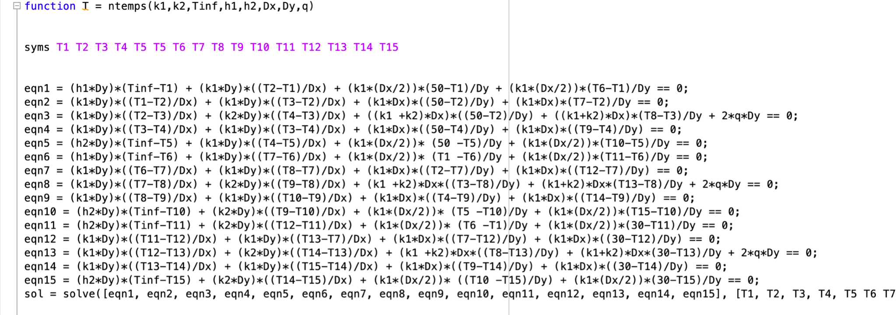
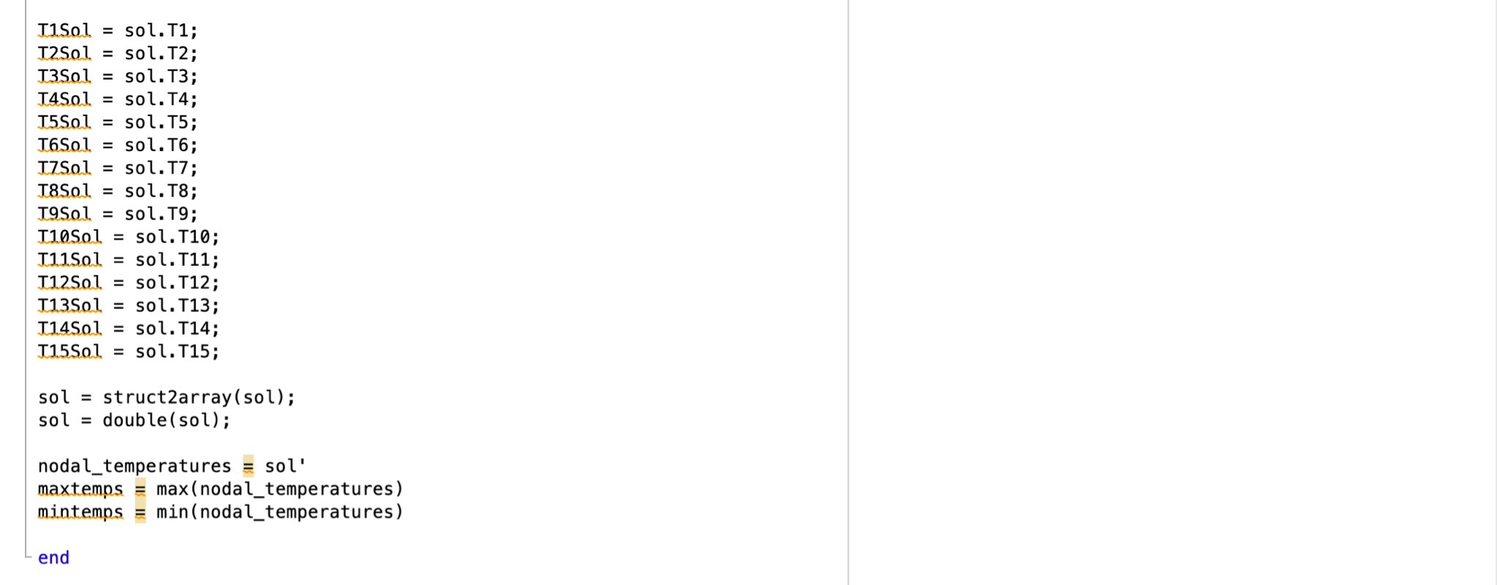
Code Documentation

Slide 6
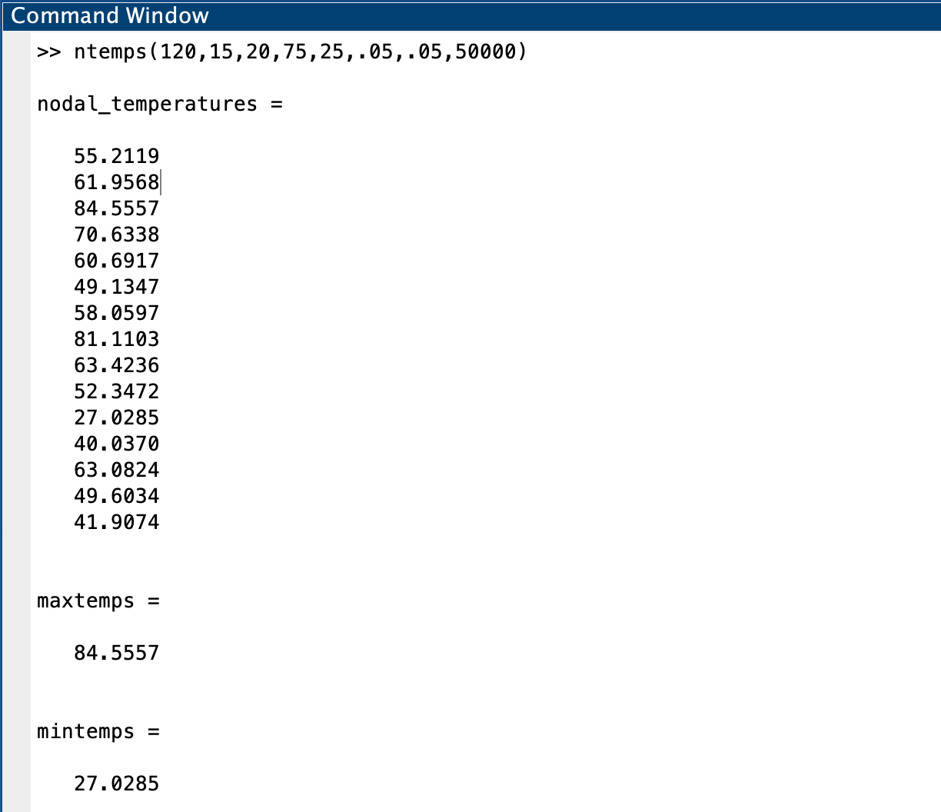
Solution

Slide 7
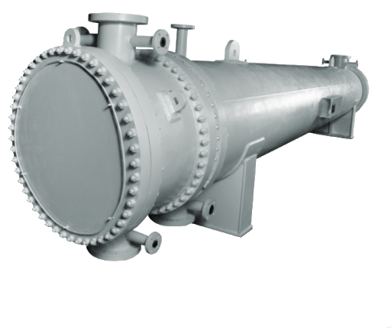
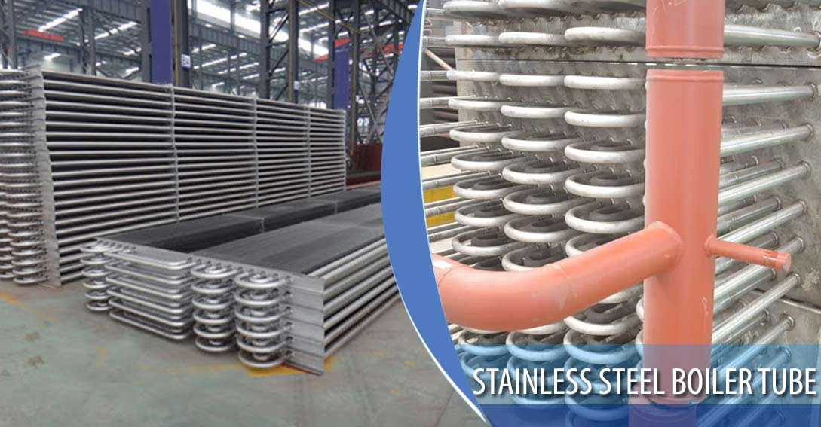

Applications
Heat Exchangers
Boiler Tubes
Cooling of Internal Combustion Engine Cylinder heads
Design of rear and front window defrosters in cars analyzing temperature distribution and steady state conditions of system
Analysis of temperature distributions of material properties after process such as quenching hardening and annealing
Trombe walls are commonly used on south sides of passive solar homes to absorb solar energy, store it during the day, and release it to the house during the night (pg. 343 Cengel)

Slide 8
Conclusion & Recommendations
Both explicit and implicit methods should be applied to the systems and compared to which results are better suited for the problem.
Two-dimensional transient heat conduction introduce methods to problems involving heat generated in a medium at a rate of e · (x, y, t), which vary with time, position, and the thermal conductivity “k” of the medium assumed to be constant.
Numerical finite difference method is based on replacing derivatives by differences, selecting a sufficient number of points in a region (nodal points), and writing energy balances on the volume elements centered about the nodes.

Slide 9
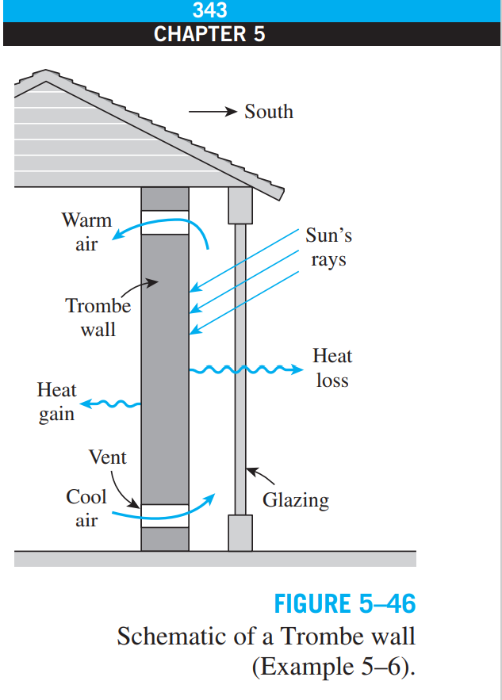
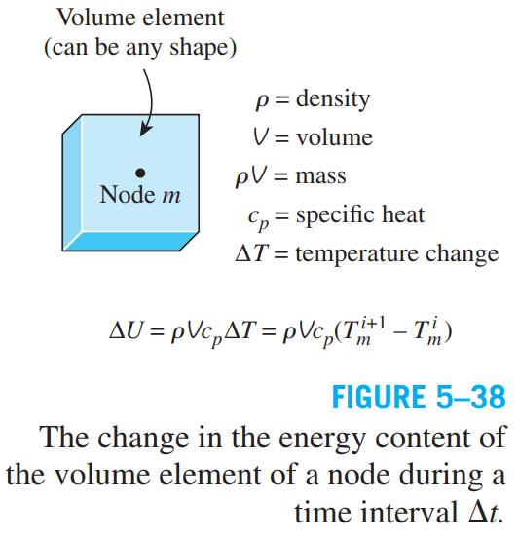
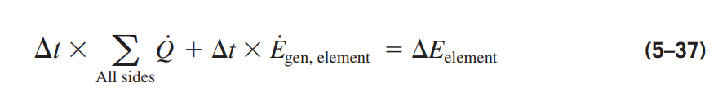
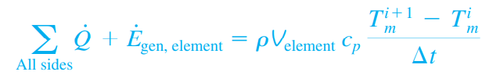
Appendix
Reference Figure 5-46: Found in textbook pg. 343 as example 5-6.
Properties: Transient heat conduction problems differ from steady state. Involving an additional term representing the changes in energy content of medium with time.
Derivations: Start with energy balance on a volume element during a time interval as equation 5-7. Further derivations for delta E shown in Figure 5-38 bring us to the final derivation for any node in a medium and its volume element as equation 5-39.

